Slide 1
object detection
Using OpenCV

Slide 2
Viola-Jones
Object Detection Framework

Slide 3
Viola-Jones Algorithm
Viola-Jones is a simplest object detection framework proposed in 2001
By Paul Viola and Michael Jones
It is MACHINE LEARNING based approach where a cascade function is trained from a lot of positive and negative images. It is then used to detect objects in other images.

Slide 4
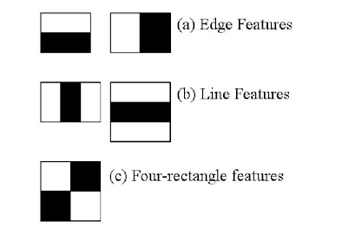
Haar Features
Step-1: This algorithm needs lot of positive images (image of faces) and negative images (images without faces) to train the classifier.
Step-2: Then we need to extract features from it using Haar Features (like convolution kernel)

Slide 5
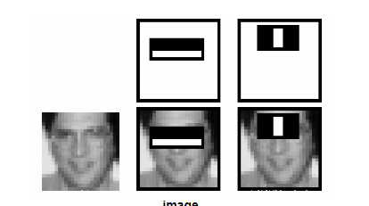
Train Machine Learning
Step-3: Each feature is a single value obtained by subtracting sum of pixels under the white rectangle from sum of pixels under the black rectangle.
Step-4: Train the features with machine learning model.

Slide 6
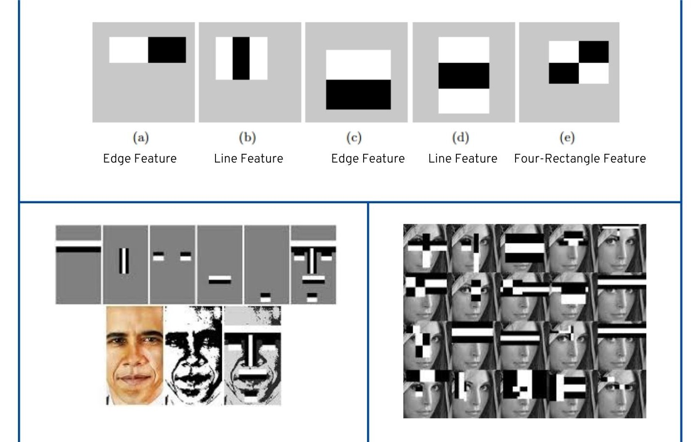
Reference
Robust Real-time Object Detection (2001)
http://citeseerx.ist.psu.edu/viewdoc/summary?doi=10.1.1.110.4868

